Slide 1
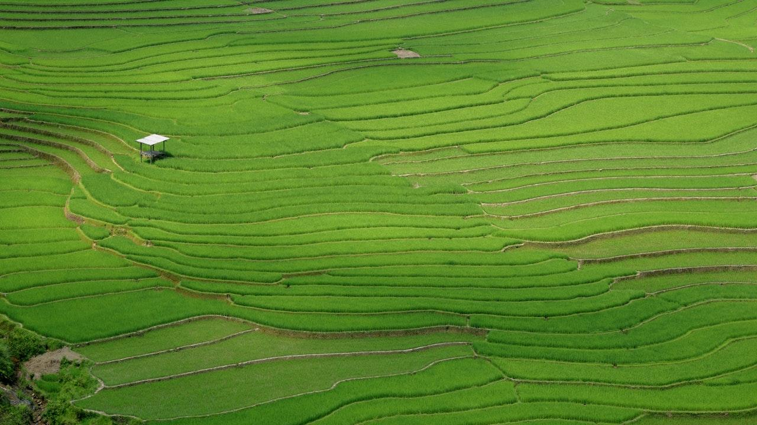
CARBON SEQUESTRATION FOR CHURCH COMMUNITIES
Slides prepared by: Shannon Bayless, Helen Larson, Jordan Ketchem, & Katelyn LeBeque
St. Olaf Students, ES 237 Spring 2020

Slide 2
Creation Care
Effort to mobilize church communities to care for God’s creation
The gospels put forth a call to action to care for creation

Slide 3
The earth is the Lord’s, and everything in it,
the world, and all who live in it;
-Psalms 24:1 (NIV)

Slide 4
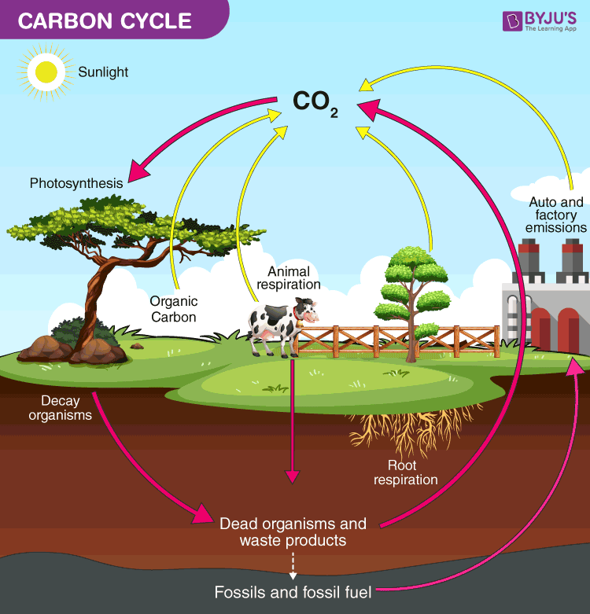
What is Carbon Sequestration?
Carbon sequestration is one part of the larger Carbon Cycle, a series of processes by which carbon is converted into different forms in the environment.

Slide 5
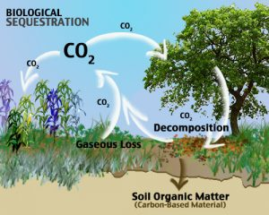
Carbon Sequestration
Plants capture and store carbon by taking CO₂ out of the atmosphere through photosynthesis.

Slide 6
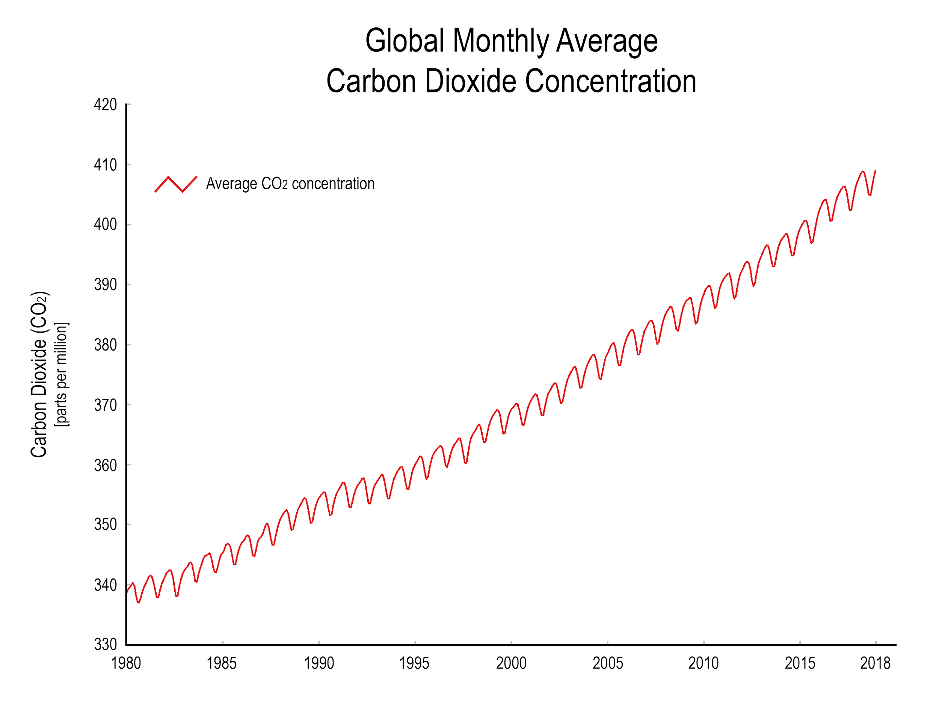
Why Carbon Sequestration?
Carbon dioxide is a greenhouse gas and contributes to global warming
Removing it from the atmosphere reduces the risk of global warming

Slide 7
Why sequester carbon in your community
Promotes community involvement
Allows community members to physically see the benefit of your work
Allows for local air quality improvement
Certain plants increase property value

Slide 8
Aligning with the Northfield Climate Action Plan
Northfield is a step 3 Green Step City!
  (see Welcome to GreenStep Cities | GreenstepCities and City Detail)
Northfield also has a Climate Action Plan, adopted Nov. 5, 2019
  This means Northfield is working towards resilience as a town as climate change gets affects the world more and more
  Increasing the carbon sequestration of your church space or other areas around town helps with some of the town’s three year targets!
Below is the link for the informative one page overview of the plan
  NORTHFIELD DRAFT CLIMATE ACTION PLAN Carbon Free Electricity by 2030 Carbon Free by 2040

Slide 9
Improving Carbon Sequestration on Your Grounds
Plant Carbon Sequestering Vegetation
Trees and thickets naturally sequester carbon
New saplings can take years to become carbon neutral, so providing proper care for existing trees is very important

Slide 10
Improving Carbon Sequestration on Your Grounds
Create a Carbon Sink Garden
Gardens sequester carbon through both the plants and the soil
Try to reduce tilling, turning over soil releases CO₂ into the atmosphere, trying perennials and letting earthworms do the work for you!

Slide 11
Improving Carbon Sequestration on Your Grounds
Reduce Emissions
Reducing emissions and increasing sequestration will help move you campus towards carbon neutrality
Try to minimize power that comes from fossil fuels, this can be in your main building or in the tools you use for property maintenance

Slide 12
Improving Carbon Sequestration in Your Town
Work With Local Cemeteries
Support the use of electric lawn equipment
Promote the planting and growth of carbon sequestering plants
Partner With a Garden Club
Offer to assist in plantings and garden maintenance

Slide 13
Improving Carbon Sequestration in Your Town
Valley Grove Tree Project
The organization is planting seven oak tree groves in the 50-acre prairie surrounding the historical church site
Help sponsor the planting and maintenance of the trees

