Slide 1
Climate Action Planning in Northfield: An Overview for the Planning Commission
February 15, 2018
Presented by : Alex Miller and Carla Hansen, EQC members

Slide 2
City of Northfield Strategic Priority #6
“A Community that’s Resilient and Sustainable”
Desired Outcomes:
A clear vision for climate action
An economy resilient to energy and environment impacts
Reduced carbon emissions
4 Initiatives Associated with the Priority 6

Slide 3
City of Northfield Strategic Priority #6: Planning for Climate Change
4 Initiatives:
Comprehensive stormwater plan
Climate communication/outreach program
Develop/deploy awareness survey
Develop and implement a Climate Action Plan (CAP)
Notes:
CAPAB is charged with developing a CAP. Some overlap will occur with all 4 initiatives.

Slide 4
Climate Action Planning Process
Three Stages
Preliminary Activities | CAP Development | CAP Implementation and Monitoring
2005 ---------------------------------------------------------- 2018 | 2018 ---- 2020 | 2020 and beyond

Slide 5
Stage 1 Preliminary Activities
City council approves a solar
subscription agreement.
Cities for Climate Protection (CC)
2005 | 2008 | 2010 | 2014 | 2016 | 2017 | 2018
City adopts resolution
to form a Climate Action Advisory Board (CAPAB).
Energy Working Group and
EQC gather information for the council about climate action planning.
Notes:
There are many other efforts in effects now and being planned: COOP, organic farming, Carleton and St.Olaf, residential practices, public transit...

Slide 6
Stage 1 Preliminary Activities (cont.)
2018
Feb | Mar | Apr-Jun
Resolution adopted Applications open Mayor appoints | EQC provides orientation for the CAPAB | CAPAB early work visioning to determine scope of plan decide on internal/external resources establish public ed. and outreach establish working groups Earth Day participation audit existing comprehensive plans, policies, ordinances, programs, etc.
Notes:
Early community engagement: The city depends on its citizens for active involvement in plan development and later citizen involvement is essential to successful plan implementation.

Slide 7
Stage 2 CAP Development
April 2018 through June 2019
BASIC PARTS OF A CAP
Define scope of the CAP to decrease GHG and to ensure an economy resilient to energy and environmental impacts.
Conduct a baseline GHG inventory (emissions)
Set targets - to reduce net carbon emissions (carbon free by 33)
Develop mitigation and adaptation strategies
Notes:
Carbon free by 33 on page 19 in the With Hope report

Slide 8
Scope of Plan
Sustainable Plan: Education, Energy, Waste, Water, Community Development, Transportation, Green Economic Development, Open Space and Ecosystem Preservation, Food. OPRF, IL
Phase I of a plan focusing on energy: Waste Reduction and Utilization, Local Energy and Renewables, Transportation, and the Built Environment. Dubuque, IA
Notes:
Some plans are phaseed.

Slide 9
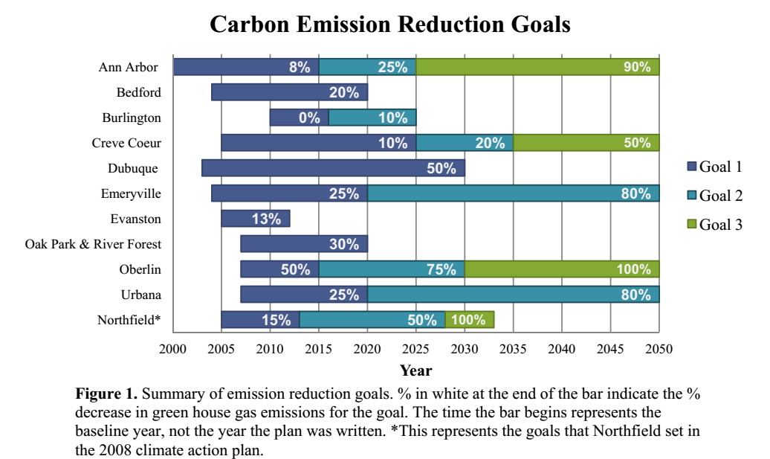
Setting Targets
Notes:
The first ten cities listed are cities that were included in the CAP Comparison study that was done in 2017 by the EWG for the EQC. Note the wide range of carbon reduction goals. For plan success strategies and targets must be realistic with city, community and financial support.

Slide 10
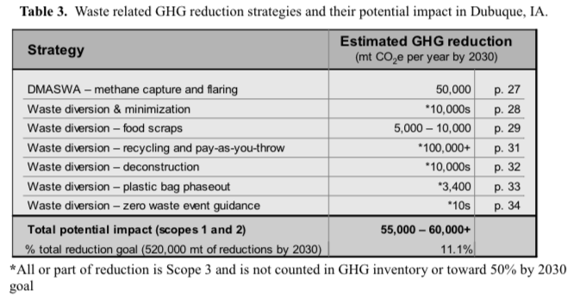
Example of a Strategy - Mitigation
Notes:
Burlington Vermont CAP

Slide 11
Stage 2 CAP Development (cont.)
2019
Jun | Aug | Sep | Oct |  | Nov | Dec
Outline of CAP to EQC | Draft of CAP to EQC | Draft of CAP to council | Final draft of CAP to EQC | EQC recommend CAP to council | EQC recommend CAP resolution to council | Adoption of CAP by council

Slide 12
Stage 3 CAP Implementation and Monitoring
January 2020
Need to have careful follow through and accounting
What is being implemented?
Who is responsible for implementation and monitoring?
How the strategy is funded or budgeted for?
Notes:
Stress the importance of monitoring as an on-going re-adjusting tweaking of polices etc.

Slide 13
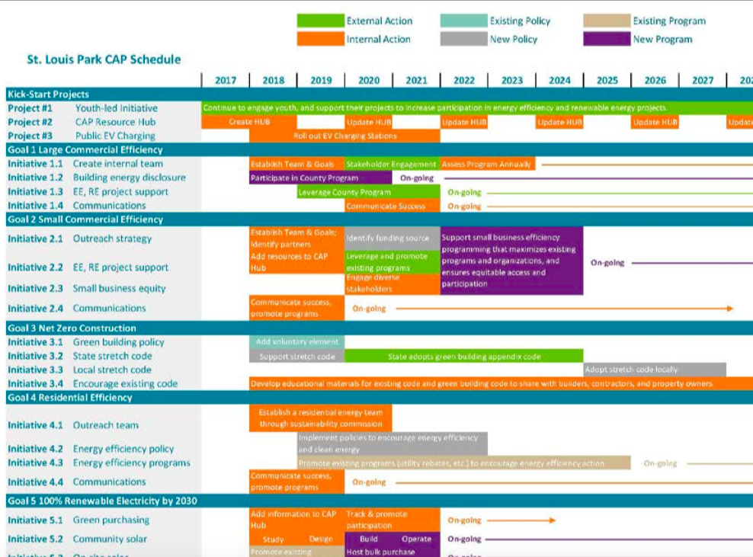
Notes:
From St. Louis Park, MN Feb. 2017 CAP

Slide 14
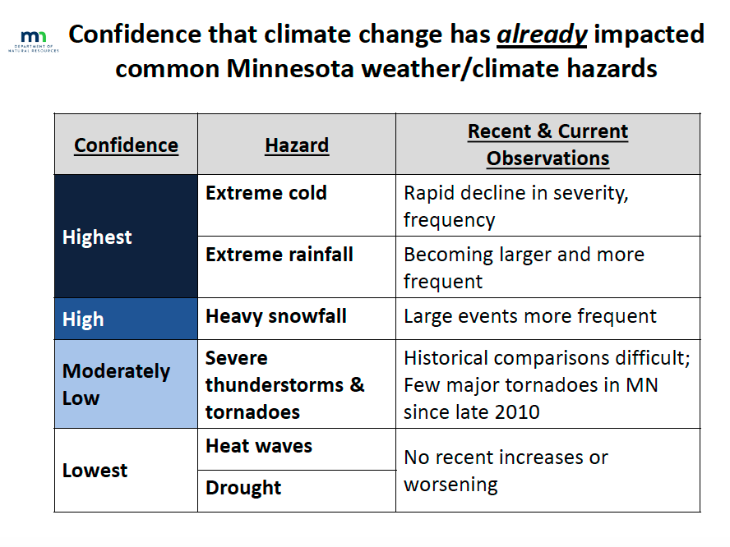
Climate Change in Minnesota
Notes:
Trend data is used instead of variability..

Slide 15
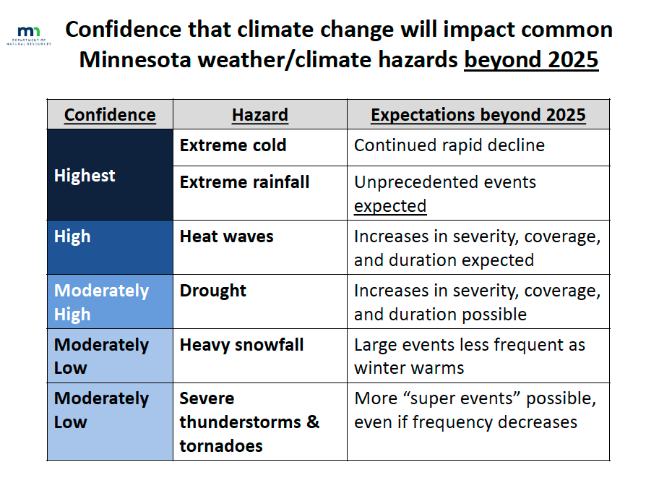
Climate Change in Minnesota

Slide 16
Local Climate Change
Less winter hurts winter businesses, outdoor winter recreation, our lakes, and our farmers’ fields.
More water damages homes and businesses and burdens our infrastructure. We “...get less value out of the water.”
Warmer temperature hurts our lakes and is causing range shift of traditional vegetation, animals, and insects.
They know what needs to be done.
Notes:
I interviewed 30 people form in and around Northfield to find out what they know about CC, what actions they are taking and what solutions they have for CC. I have long lists of all the social ecological and environmental consequences of those climate changes.

Slide 17
Local Climate Change
The citizens suggest that the City:
Provides more climate change/sustainable education in the schools and the community.
Support its citizens by initiating, updating, and enforcing policies, codes and incentives that will ensure
green or smart building practices
make renewable energy options available
require better land use practices
provide additional public transportation options.
Notes:
The community needs the tools to participate in the mitigation of and adapting to CC.

Slide 18
CAP Development and the Planning Commission
“The built environment is a primary contributor to climate change and GHG emissions …. Importance must be placed on changing development patterns, transportation systems and regulations ….”
“Changing societal actions can slow the pace of climate change, mitigate the changes that do occur and allow adaptation to the ultimate effects of climate change.”
American Planning Association
Notes:
What hits me the hardest about those statements is the fact that we have the ability to help our citizens understand climate change and we have the ability to help them participate in its mitigation and adaptation by the community plans, standards, ordinances, programs, and policies that we manage.

Slide 19
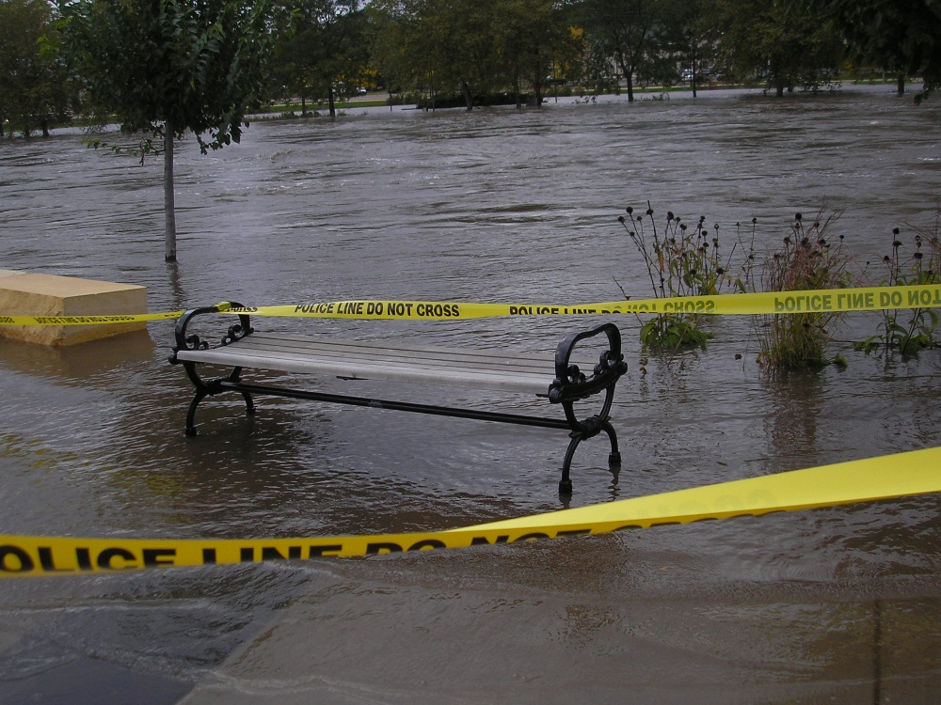
Final Thoughts
Northfield
Notes:
“Unprecedented events expected” MNPCA
“These are events in which six inches of rain covers more than 1000 square miles and the core of the event topped eight inches.” MNDNR

Slide 20
Working with Others
People of Northfield
City Council
Climate Action Plan
Advisory Board
(CAPAB)
EQC
Planning
Commission
Parks and Recreation
CAPAB
working
groups
HPC
EDA
HRA
Arts and Culture
and others
to contact
contacted

